Slide 1
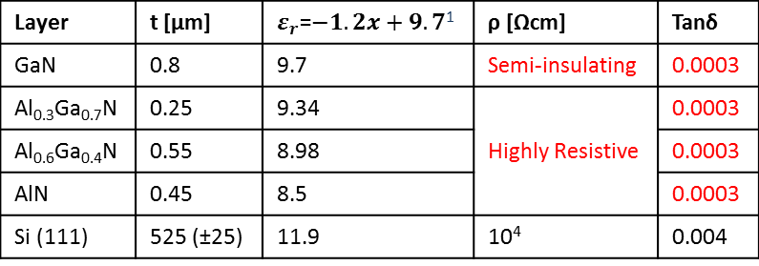
Nitronex AlGaN/GaN Template
These thicknesses and mol fractions are valid for the Nitronex templates we have – other AlGaN/GaN templates have similar composition – mol fraction or thicknesses can be slightly different.
The structure on this page does not have the top 2 layers: on top of GaN, there is a 17nm AlGaN layer and at the very top a 2nm GaN layer. 2DEG exists between the 0.8um GaN and 17nm AlGaN.
2DEG removed Nitronex template
Layer | t [μm] | $ε_{r}$=$−1.2x+9.7$¹ | ρ [Ωcm] | Tanδ
GaN | 0.8 | 9.7 | Semi-insulating | 0.0003
Al_{0.3}Ga_{0.7}N | 0.25 | 9.34 | Highly Resistive | 0.0003
Al_{0.6}Ga_{0.4}N | 0.55 | 8.98 |  | 0.0003
AlN | 0.45 | 8.5 |  | 0.0003
Si (111) | 525 (±25) | 11.9 | 10⁴ | 0.004
¹ Theoretical Study of a GaN-AlGaN HEMT Including a Nonlinear Polarization Model, Yu et. al, IEEE Trans on Electron Devices, V50, N2, 2003, p315-323

